Slide 1

Use of Intelligent Solar Panels to Facilitate Carbon Trading
Gichira Alvin Kaburu
P15/1553/2015

Slide 2



Recap

Slide 3
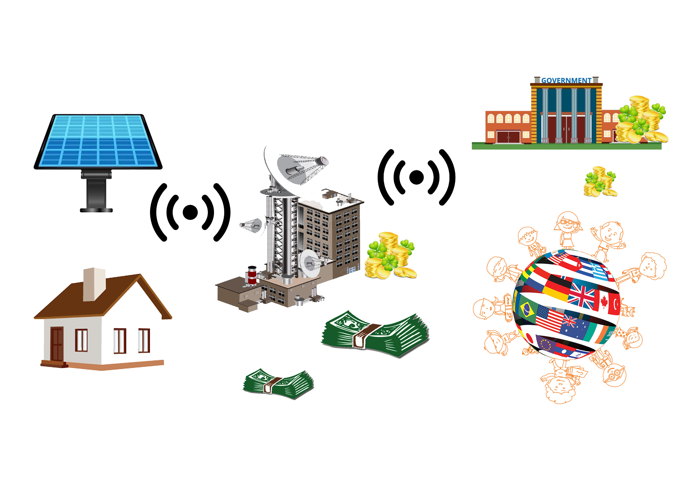
How It Works

Slide 4
Objectives

Slide 5
Research Objectives
The goal of this project is to facilitate carbon trading through the use of intelligent solar panels.

Slide 6
System Objectives
To modify an existing solar panel by adding the ability to collect data from its owners while following the sun.
To use the data collected to calculate extra carbon credits sold through the carbon market.
To facilitate financial benefit to individuals and body corporates through the sale of carbon credits.

Slide 7
Gantt Chart

Slide 8
ID | Task Name | Feb | Mar | Apr |  | May | June |  | Jul | Aug |  | Sept | Oct
1 | Research
2 | Planning
3 | Testing of Alternatives
4 | Choice Implementation plan and Design
5 | Assembling of Hardware Components
6 | Testing of Hardware components
7 | Software components design and testing
8 | Integrating Hardware and Software
9 | Overall Testing
10 | Review
11 | Documentation

Slide 9
Use of Intelligent Solar Panels to Facilitate Carbon Trading
The End

